Slide 1
Fundamentals of Logic
Chapter 2
1. What is a valid argument or proof?
2. Study system of logic
3. In proving theorems or solving problems, creativity and insight are needed, which cannot be taught

Slide 2
Chapter 2. Fundamentals of Logic
2.1 Basic connectives and truth tables
statements (propositions): declarative sentences that are
either true or false--but not both.
Eg. Margaret Mitchell wrote Gone with the Wind.
2+3=5.
not statements:
What a beautiful morning!
Get up and do your exercises.

Slide 3
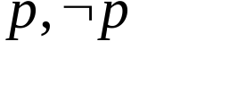
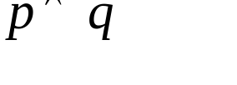
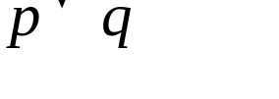
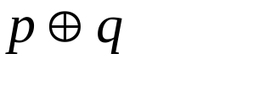
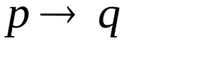
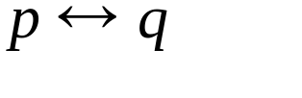
Chapter 2. Fundamentals of Logic
2.1 Basic connectives and truth tables
primitive and compound statements
combined from primitive statements by logical connectives
or by negation ( )
logical connectives:
(a) conjunction (AND):
(b) disjunction(inclusive OR):
(c) exclusive or:
(d) implication: (if p then q)
(e) biconditional: (p if and only if q, or p iff q)

Slide 4
Chapter 2. Fundamentals of Logic
2.1 Basic connectives and truth tables
"The number x is an integer." is not a statement because its
truth value cannot be determined until a numerical value
is assigned for x.
First order logic vs. predicate logic

Slide 5
Chapter 2. Fundamentals of Logic
2.1 Basic connectives and truth tables
Truth Tables
p q
0 0 0 0 0 1 1
0 1 0 1 1 1 0
1 0 0 1 1 0 0
1 1 1 1 0 1 1

Slide 6
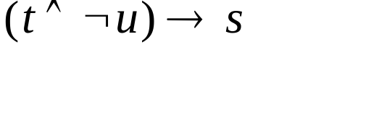
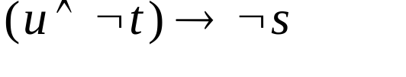
Chapter 2. Fundamentals of Logic
2.1 Basic connectives and truth tables
Ex. 2.1
s: Phyllis goes out for a walk.
t: The moon is out.
u: It is snowing.
: If the moon is out and it is not snowing, then
Phyllis goes out for a walk.
If it is snowing and the moon is not out, then Phyllis
will not go out for a walk.

Slide 7
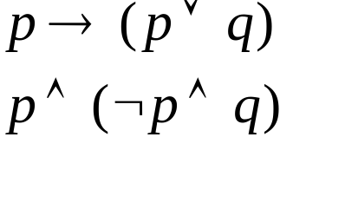
Chapter 2. Fundamentals of Logic
2.1 Basic connectives and truth tables
Def. 2.1. A compound statement is called a tautology(T₀) if it is
true for all truth value assignments for its component statements.
If a compound statement is false for all such assignments, then it is called a contradiction(F₀).
: tautology
: contradiction

Slide 8
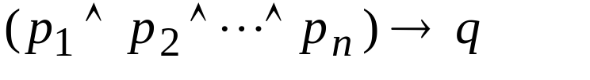
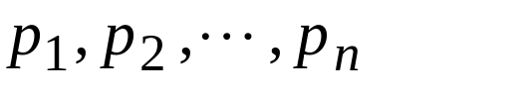
Chapter 2. Fundamentals of Logic
2.1 Basic connectives and truth tables
an argument:
premises
conclusion
If any one of
is false, then no matter what
truth value q has, the implication is true. Consequently,
if we start with the premises
--each with
truth value 1--and find that under these circumstances
q also has value 1, then the implication is a tautology and
we have a valid argument.

Slide 9
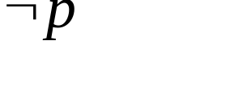
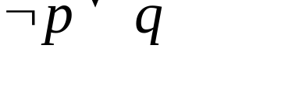
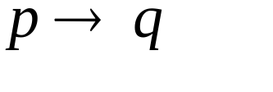
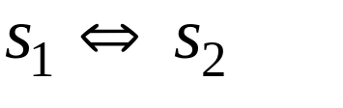
Chapter 2. Fundamentals of Logic
2.2 Logical Equivalence: The Laws of Logic
Ex. 2.7
p
q
0
0
1
1
0
1
0
1
1
1
0
0
1
1
0
1
1
1
0
1
Def 2.2 . logically equivalent

Slide 10
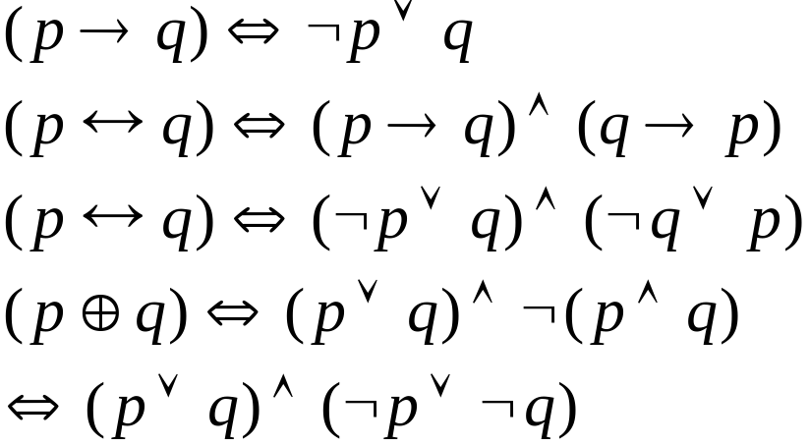


Chapter 2. Fundamentals of Logic
2.2 Logical Equivalence: The Laws of Logic
logically equivalent
We can eliminate the connectives
and
from compound statements.
(and,or,not) is a complete set.

Slide 11
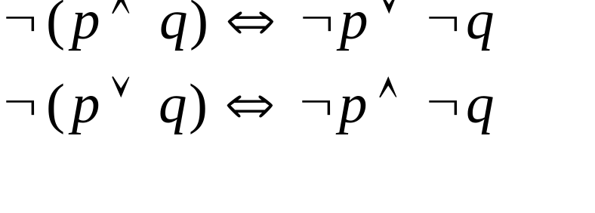
Chapter 2. Fundamentals of Logic
2.2 Logical Equivalence: The Laws of Logic
Ex 2.8. DeMorgan's Laws
p and q can be any compound statements.

Slide 12
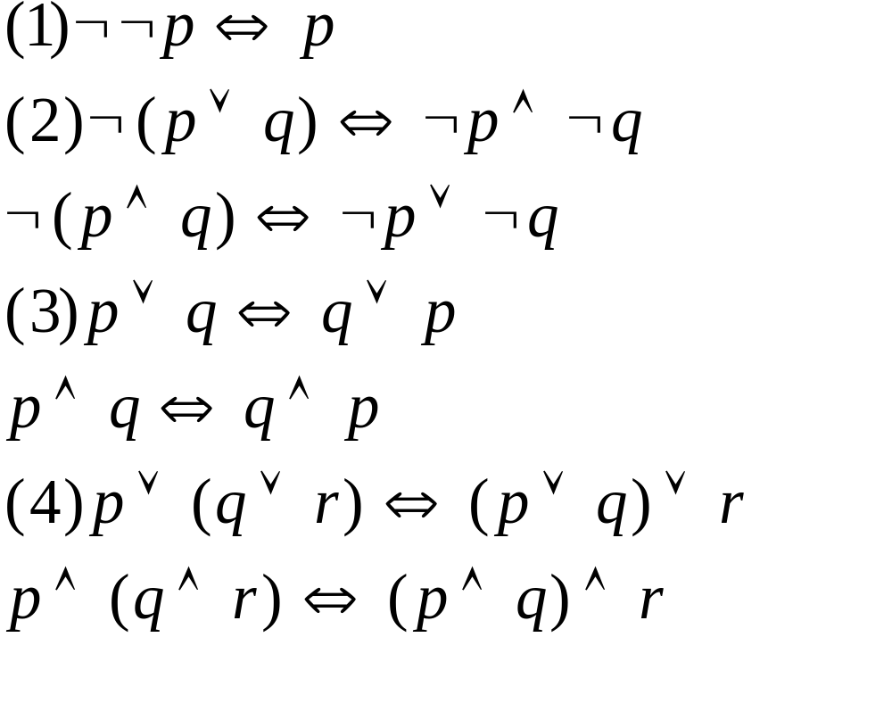
Chapter 2. Fundamentals of Logic
2.2 Logical Equivalence: The Laws of Logic
Law of Double Negation
Demorgan's Laws
Commutative Laws
Associative Laws

Slide 13
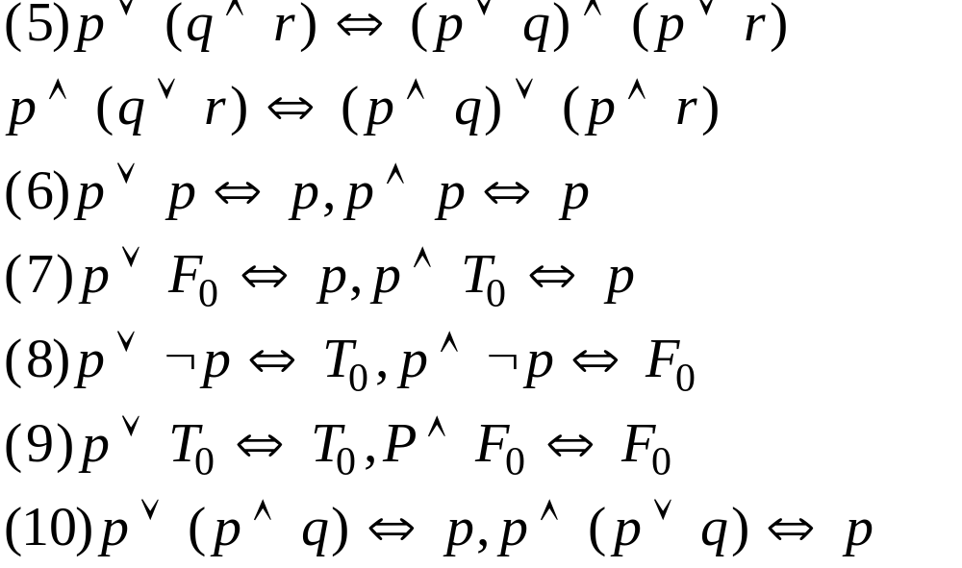
Chapter 2. Fundamentals of Logic
2.2 Logical Equivalence: The Laws of Logic
Distributive Law
Idempotent Law
Identity Law
Inverse Law
Domination Law
Absorption Law

Slide 14


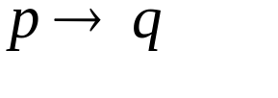
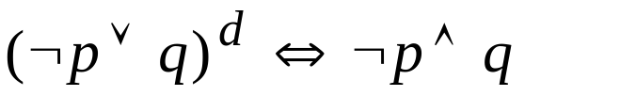
Chapter 2. Fundamentals of Logic
2.2 Logical Equivalence: The Laws of Logic
All the laws, aside from the Law of Double Negation, all
fall naturally into pairs.
Def. 2.3 Let s be a statement. If s contains no logical connectives
other than and , then the dual of s, denoted s^{d}, is the
statement obtained from s by replacing each occurrence of
and by and , respectively, and each occurrence of T₀
and F₀ by F₀ and T₀, respectively.
Eg.
The dual of is

Slide 15
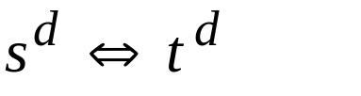

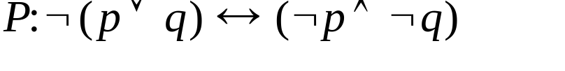

Chapter 2. Fundamentals of Logic
2.2 Logical Equivalence: The Laws of Logic
Theorem 2.1 (The Principle of Duality) Let s and t be statements.
If , then .
First Substitution Rule (replace each p by another statement q)
Ex. 2.10
is a tautology. Replace
each occurrence of p by
is also a tautology.

Slide 16
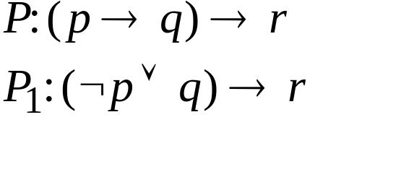
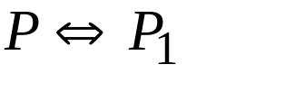
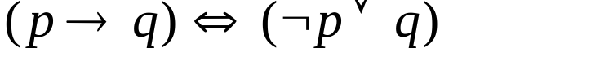
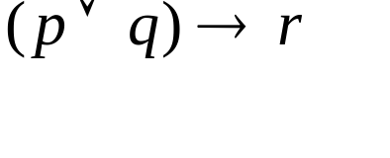
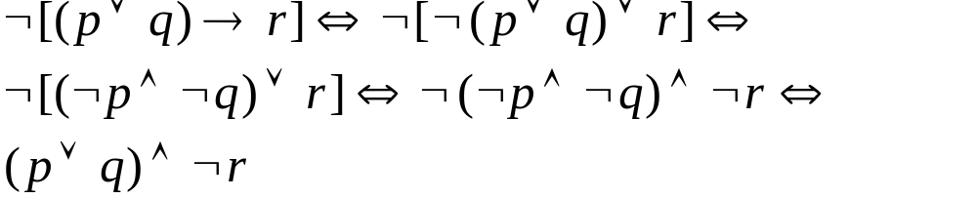
Chapter 2. Fundamentals of Logic
2.2 Logical Equivalence: The Laws of Logic
Second Substitution Rule
Ex. 2.11
Then,
because
Ex. 2.12 Negate and simplify the compound statement

Slide 17
Chapter 2. Fundamentals of Logic
2.2 Logical Equivalence: The Laws of Logic
Ex. 2.13 What is the negation of "If Joan goes to Lake George,
then Mary will pay for Joan's shopping spree."?
Because
The negation is "Joan goes to Lake George, but (or and)
Mary does not pay for Joan's shopping spree."

Slide 18
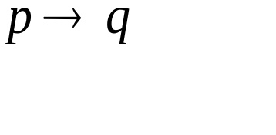
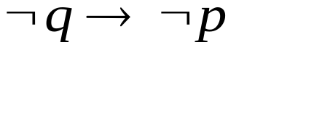
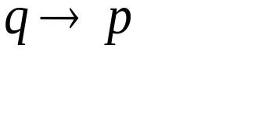
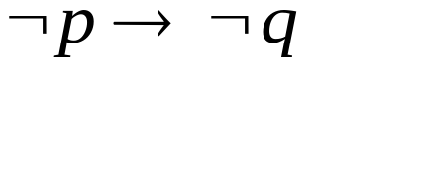
Chapter 2. Fundamentals of Logic
2.2 Logical Equivalence: The Laws of Logic
Ex. 2.15
contrapositive of
p
q
0
0
1
1
0
1
0
1
1
1
0
1
1
1
0
1
1
0
1
1
1
0
1
1
converse
inverse

Slide 19


Chapter 2. Fundamentals of Logic
2.2 Logical Equivalence: The Laws of Logic
Compare the efficiency of two program segments.
z:=4;
for i:=1 to 10 do
begin
x:=z-1;
y:=z+3*i;
if ((x>0) and (y>0)) then
writeln(‘The value of the sum x+y is’, x+y)
end
.
.
.
if x>0 then
if y>0 then
…
Number of comparisons?
20 vs. 10+3=13
logically equivalent

Slide 20
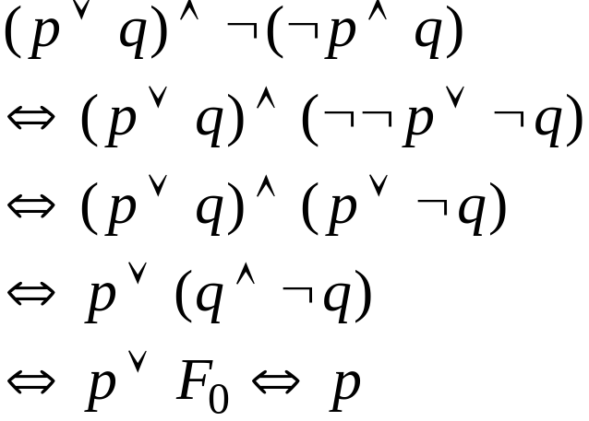
Chapter 2. Fundamentals of Logic
2.2 Logical Equivalence: The Laws of Logic
simplification of compound statement
Ex. 2.16
Demorgan's Law
Law of Double Negation
Distributive Law
Inverse Law and
Identity Law

Slide 21
Chapter 2. Fundamentals of Logic
2.3 Logical Implication: Rules of Inference
an argument:
premises
conclusion
is a valid argument
is a tautology

Slide 22
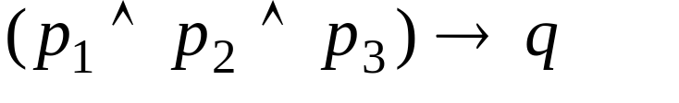
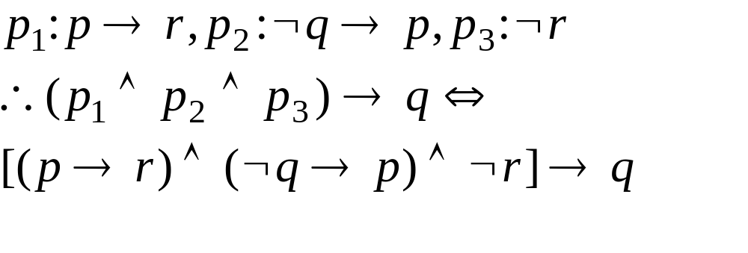
Chapter 2. Fundamentals of Logic
2.3 Logical Implication: Rules of Inference
Ex. 2.19 statements: p: Roger studies. q: Roger plays tennis.
r: Roger passes discrete mathematics.
premises: p₁: If Roger studies, then he will pass discrete math.
p₂: If Roger doesn't play tennis, then he'll study.
p₃: Roger failed discrete mathematics.
Determine whether the argument
is valid.
which is a tautology,
the original argument
is true

Slide 23
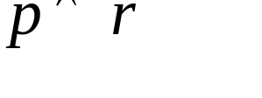
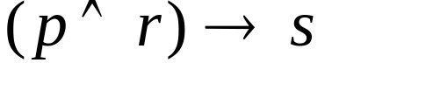
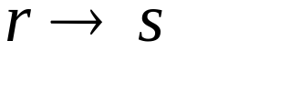

Chapter 2. Fundamentals of Logic
2.3 Logical Implication: Rules of Inference
Ex. 2.20
p r s
0 0 0 0 1 1 1
0 0 1 0 1 1 1
0 1 0 0 1 0 1
0 1 1 0 1 1 1
1 0 0 0 1 1 1
1 0 1 0 1 1 1
1 1 0 1 0 0 1
1 1 1 1 1 1 1
a tautology
deduced or
inferred from
the two
premises

Slide 24
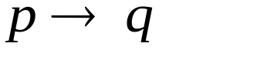
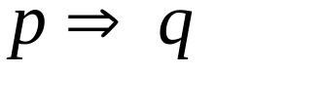
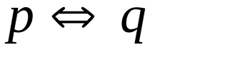
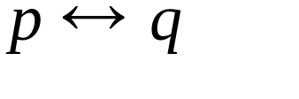
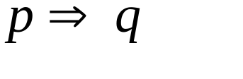

Chapter 2. Fundamentals of Logic
2.3 Logical Implication: Rules of Inference
Def. 2.4. If p, q are any arbitrary statements such that
is a tautology, then we say that p logically implies q and we
write
to denote this situation.
means
is a tautology.
means
is a tautology.

Slide 25
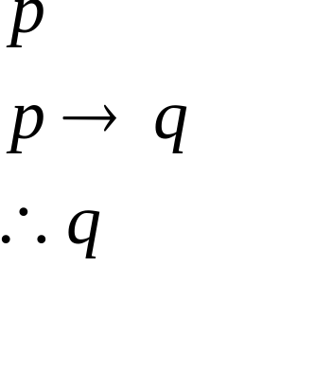
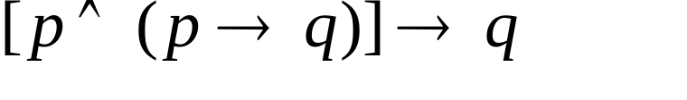
Chapter 2. Fundamentals of Logic
2.3 Logical Implication: Rules of Inference
rule of inference: use to validate or invalidate a logical
implication without resorting to truth table (which will be
prohibitively large if the number of variables are large)
Ex 2.22 Modus Ponens (the method of affirming)
or the Rule of Detachment

Slide 26
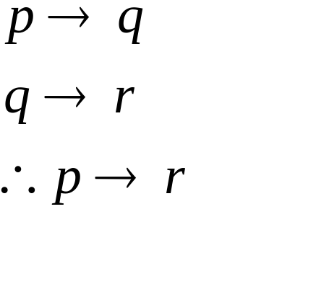
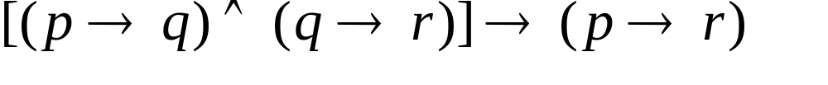
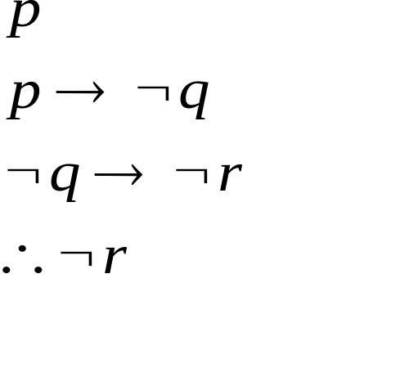
Chapter 2. Fundamentals of Logic
2.3 Logical Implication: Rules of Inference
Example 2.23 Law of the Syllogism
Ex 2.25

Slide 27
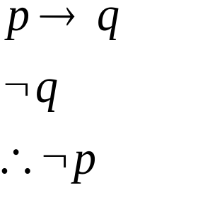
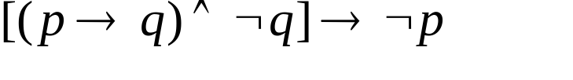







Chapter 2. Fundamentals of Logic
2.3 Logical Implication: Rules of Inference
Ex. 2.25 Modus Tollens (method of denying)
example:

Slide 28


Chapter 2. Fundamentals of Logic
2.3 Logical Implication: Rules of Inference
Ex. 2.25 Modus Tollens (method of denying)
example:
another reasoning

Slide 29

Chapter 2. Fundamentals of Logic
2.3 Logical Implication: Rules of Inference
fallacy
(1) If Margaret Thatcher is the president of the U.S., then she
is at least 35 years old.
(2) Margaret Thatcher is at least 35 years old.
(3) Therefore, Margaret Thatcher is the president of the US.

Slide 30


Chapter 2. Fundamentals of Logic
2.3 Logical Implication: Rules of Inference
fallacy
(1) If 2+3=6, then 2+4=6.
(2) 2+3
(3) Therefore, 2+4
6
6

Slide 31


Chapter 2. Fundamentals of Logic
2.3 Logical Implication: Rules of Inference
Ex 2.26 Rule of Conjunction
Ex. 2.27 Rule of Disjunctive Syllogism

Slide 32



Chapter 2. Fundamentals of Logic
2.3 Logical Implication: Rules of Inference
Ex. 2.28 Rule of Contradiction
Proof by Contradiction
To prove
we prove

Slide 33




Chapter 2. Fundamentals of Logic
2.3 Logical Implication: Rules of Inference
Ex. 2.29

Slide 34


Chapter 2. Fundamentals of Logic
2.3 Logical Implication: Rules of Inference
Ex. 2.30
q
r, s
p, t
u
No systematic way to prove except by truth table (2^{n}).

Slide 35


Chapter 2. Fundamentals of Logic
2.3 Logical Implication: Rules of Inference
Ex 2.32 Proof by Contradiction
q
r
F₀

Slide 36



Chapter 2. Fundamentals of Logic
2.3 Logical Implication: Rules of Inference
reasoning

Slide 37




Chapter 2. Fundamentals of Logic
2.3 Logical Implication: Rules of Inference
Ex 2.33
r
u, s
p

Slide 38



Chapter 2. Fundamentals of Logic
2.3 Logical Implication: Rules of Inference
How to prove that an argument is invalid?
Just find a counterexample (of assignments) for it !
Ex 2.34 Show the following to be invalid.
p=1
q=0
1
r=1
0
s=0,t=1

Slide 39
Chapter 2. Fundamentals of Logic
2.4 The Use of Quantifiers
Def. 2.5 A declarative sentence is an open statement if
(1) it contains one or more variables, and
(2) it is not a statement, but
(3) it becomes a statement when the variables in it are replaced
by certain allowable choices.
universe
examples: The number x+2 is an even integer.
x=y, x>y, x<y, ...

Slide 40




Chapter 2. Fundamentals of Logic
2.4 The Use of Quantifiers
notations:
p(x): The number x+2 is an even integer.
q(x,y): The numbers y+2, x-y, and x+2y are even integers.
p(5): FALSE,
: TRUE, q(4,2): TRUE
p(6): TRUE,
: FALSE, q(3,4): FALSE
Therefore,
For some x, p(x) is true.
For some x,y, q(x,y) is true.
For some x, is true.
For some x,y, is true.

Slide 41



Chapter 2. Fundamentals of Logic
2.4 The Use of Quantifiers
existential quantifier: For some x:
universal quantifier: For all x:
x in p(x): free variable
x in : bound variable
is either
true or false.

Slide 42


Chapter 2. Fundamentals of Logic
2.4 The Use of Quantifiers
Ex 2.36
universe: real numbers
x=4
x=1
x=5,6,...
x=-1

Slide 43



Chapter 2. Fundamentals of Logic
2.4 The Use of Quantifiers
Ex 2.37 implicit quantification
is
"The integer 41 is equal to the sum of two perfect squares."
is

Slide 44



Chapter 2. Fundamentals of Logic
2.4 The Use of Quantifiers
Def. 2.6 logically equivalent for open statement p(x) and q(x)
, i.e.,
for any x
p(x) logically implies q(x)

Slide 45




Chapter 2. Fundamentals of Logic
2.4 The Use of Quantifiers
Ex. 2.42 Universe: all integers
then
is false
but
is true
Therefore,
but
for any p(x), q(x) and universe

Slide 46

Chapter 2. Fundamentals of Logic
2.4 The Use of Quantifiers
For a prescribed universe and any open statements p(x), q(x):
Note this!

Slide 47

Chapter 2. Fundamentals of Logic
2.4 The Use of Quantifiers
How do we negate quantified statements that involve a single
variable?

Slide 48


Chapter 2. Fundamentals of Logic
2.4 The Use of Quantifiers
Ex. 2.44
p(x): x is odd.
q(x): x²-1 is even.
Negate
(If x is odd, then x²-1 is even.)
There exists an integer x such that x is odd and x²-1 is odd.
(a false statement, the original is true)

Slide 49

Chapter 2. Fundamentals of Logic
2.4 The Use of Quantifiers
multiple variables

Slide 50



Chapter 2. Fundamentals of Logic
2.4 The Use of Quantifiers
BUT
Ex. 2.48 p(x,y): x+y=17.
: For every integer x, there exists an integer y such
that x+y=17. (TRUE)
: There exists an integer y so that for all integer x,
x+y=17. (FALSE)
Therefore,

Slide 51

Chapter 2. Fundamentals of Logic
2.4 The Use of Quantifiers
Ex 2.49

Slide 52
Chapter 2. Fundamentals of Logic
Exercises. Exercise 2.2: 20
Exercise 2.3: 10
Exercise 2.4: 18, 26

